Slide 1
Resources provided by the Climate Data Store for adaptation to climate change
ECCA 2019
Jorge Paz

Slide 2
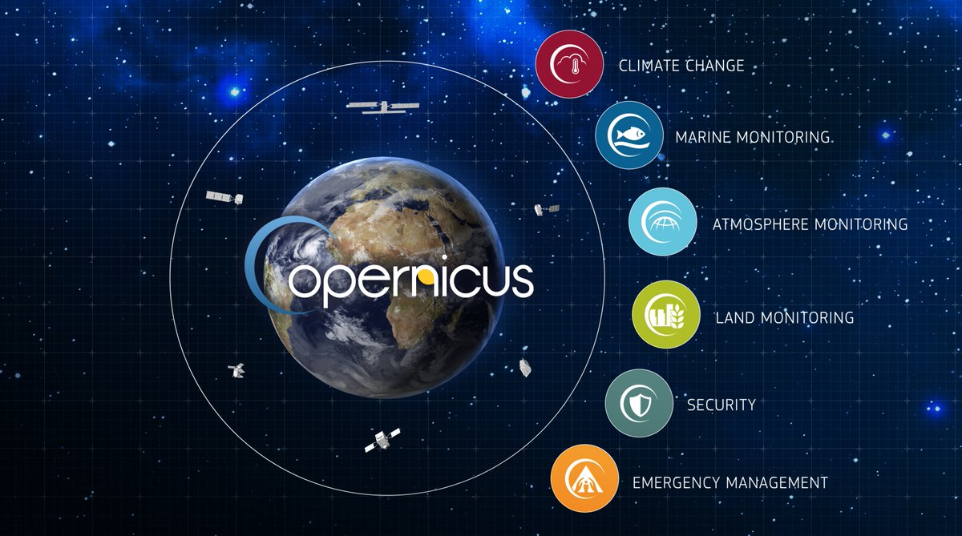
Introduction to Copernicus Climate Change Service
Introduction to Copernicus Climate Change Service
The Copernicus Climate Change Service (C3S) is one of six thematic information services provided by the European Union’s Copernicus Earth Observation Programme. C3S supports society by providing authoritative information about the past, present and future climate in Europe and the rest of the World.
C3S is implemented by the European Centre for Medium-Range Weather Forecasts (ECMWF) on behalf of the European Commission.
In collaboration with 200 companies and organisations across Europe,

Slide 3
Types of climate change information provided by the C3S
Introduction to Copernicus Climate Change Service
Climate information for different time horizons
Observations
Seasonal forecast
Long term projections
Reanalysis
Today
Months
Years
Decades

Slide 4
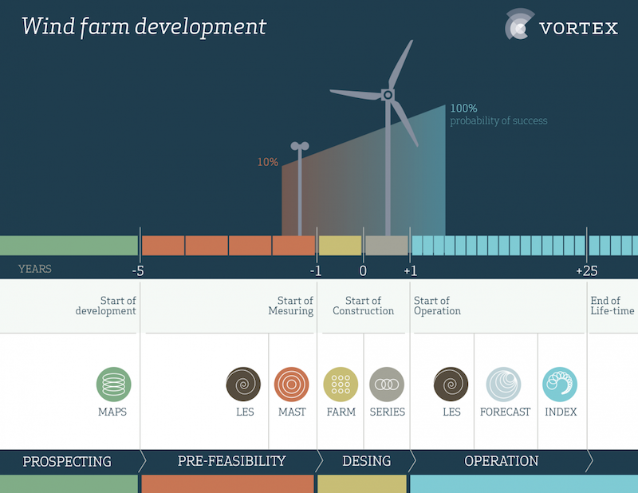
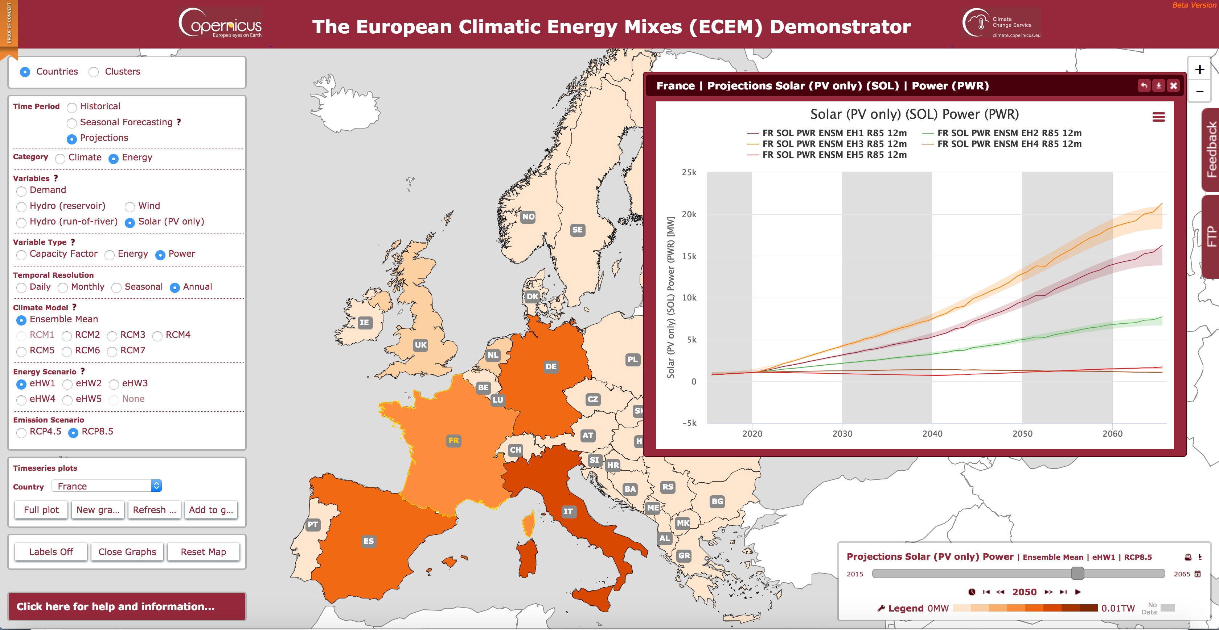

Sectorial information
Examples of cases
C3S provides data, tools and information that can help the private and public sectors deal with climate-related decision-making and planning. User-driven applications that make climate data accessible and relevant to their needs.
Water management (river flow projections)
Agriculture and forestry
Insurance (Windstorms)
Energy (e.g. renewables potential)
Infrastructure (cities)
Health
Coastal areas
Transport (Sea)
Tourism
Etc.
Ad-hoc Services
Demonstrators
Data

Slide 5
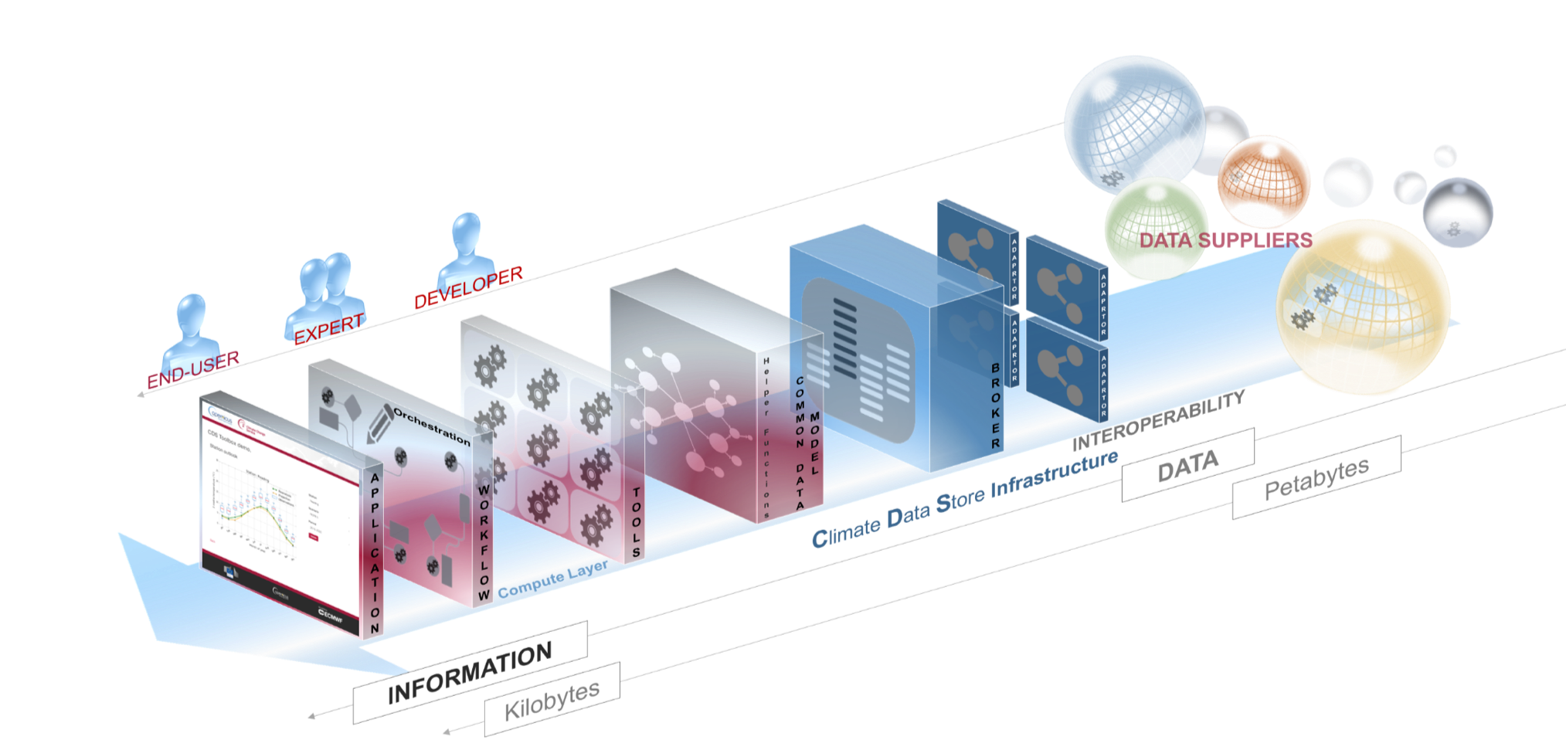
C3S Data Store (CDS)
Introduction to Copernicus Climate Change Service

Slide 6
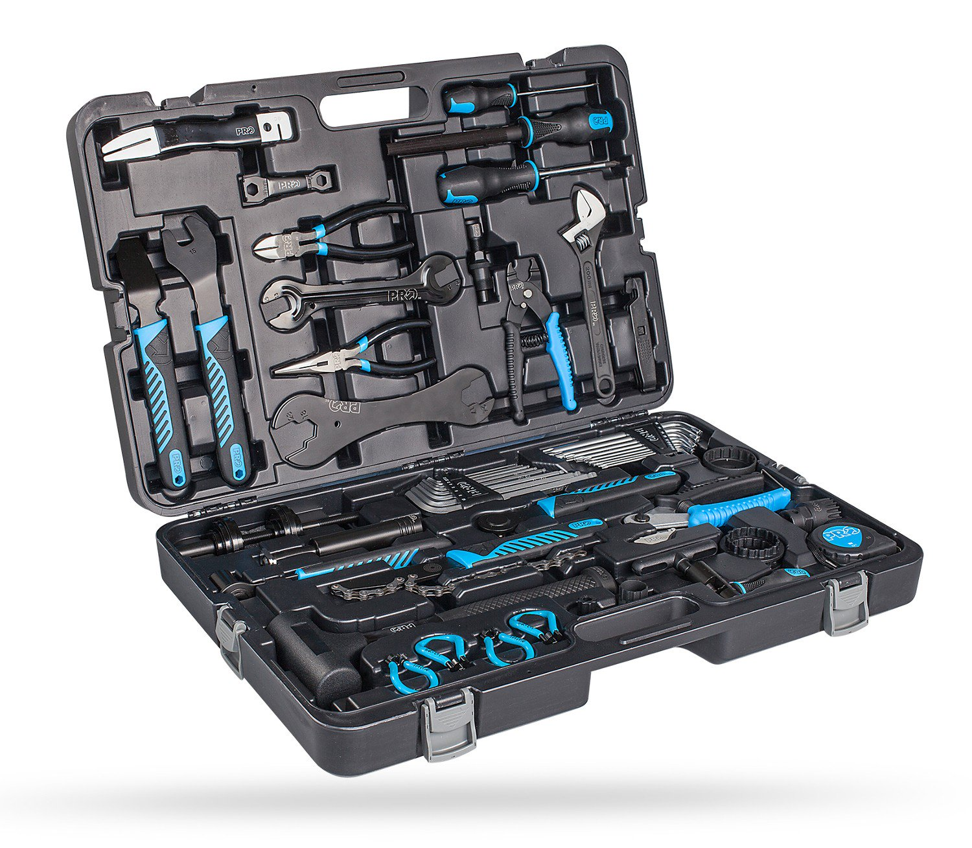
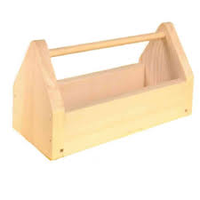
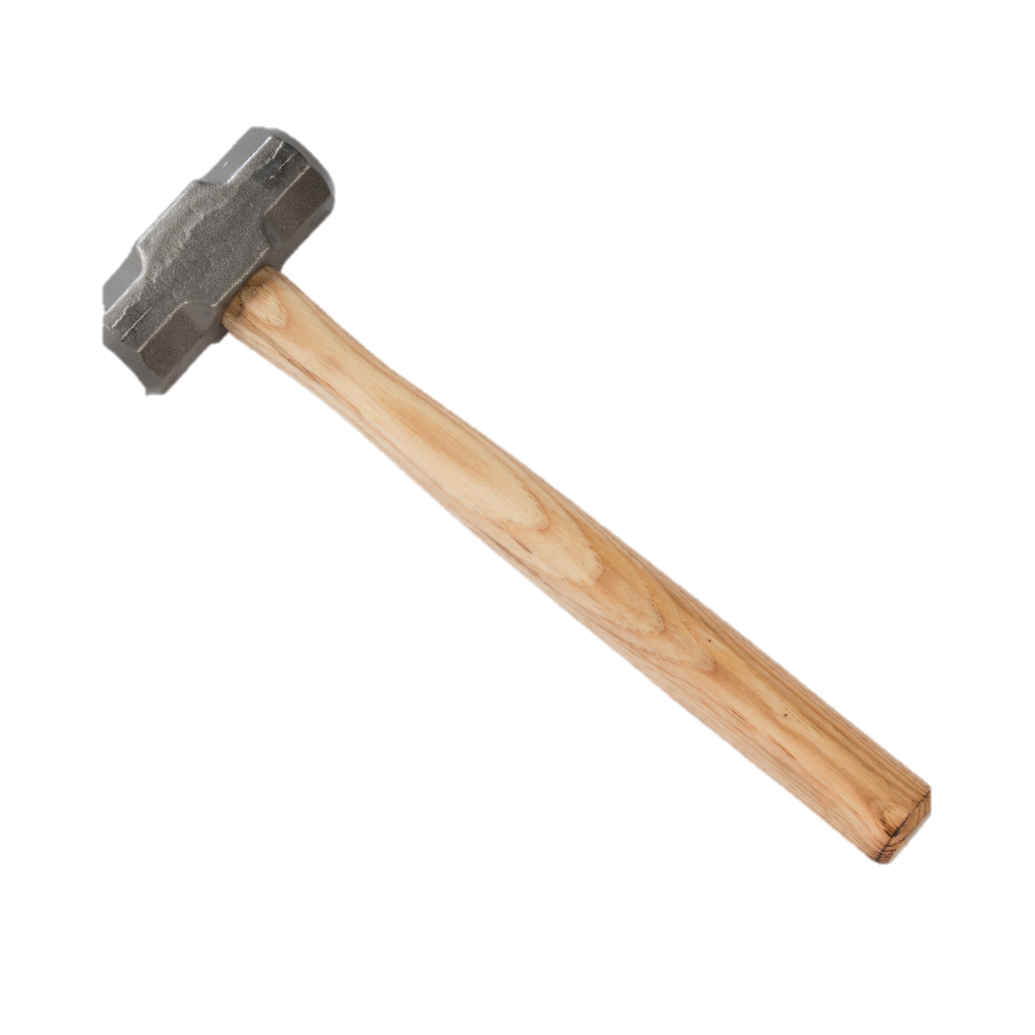
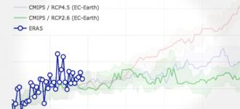

C3S Climate Data Store
CDS Toolbox
CDS API
Integrated web environment ready to be used
Great but limited capabilities
Outputs: graphs and raw data
Free computational resources provided by C3S
Helpdesk and support (User Learning Service)
Only download. A working environment must be configured for data processing, visualization, etc.
Can be integrated with other tools
Requires your own computational resources
DIY

Slide 7
Exercises
Data discover: Identification of ERA5 variables, dates, etc. of interes.
CDS API: Identification of ERA5 and downloading (loop)
Visualization with Panoply
CDS API: Download of several files
Climata data processing: plotting an netCDF file.
CDS Toolbox: plot a map
CDS Toolbox: geographical extension

Slide 8
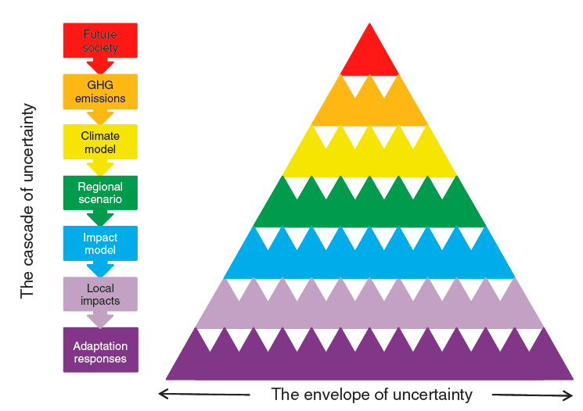
The contribution of SIS to climate change adaptation comunity
Examples of cases
GCM outputs (“homogenized”)
RCM outputs (“homogenized”)
Observations and reanalysis for bias correction, statistical downscaling, baseline generation, etc.
Documentation, use cases, examples etc: authoritative methodologies
Sectorial indicators: Free and authoritative “levels” of the cascade

Slide 9



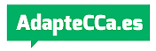


Copernicus in the context of other sources of climate data (I)
 | Copernicus Climate Change Service | Visor de Escenarios de Cambio Climático | Escenarios proyectados de cambio climático en el País Vasco
Data | Reanalysis Observations Seasonal Forecasts Sectorial indicators sectoriales: River flow, Wind Capacity Factor, etc. Long term climate projections (CMIP5). New information is being added. | Specific observations (AEMET stations) Grid observations (Spain011) Grid projections, from the dynamic regionalizations generated in the international initiative Euro-CORDEX1 Point projections, obtained by applying statistical regionalization techniques to data from a series of locations in the AEMET network of stations. | A climatic atlas (daily data of the period 1971-2015) of high spatial resolution (1km x 1km) of basic variables (precipitation, average temperatures, maximum temperature and minimum temperature): 1) Historical data of meteorological stations (daily basic variables) 2) High resolution historical climatology of the Basque Autonomous Community (daily basic variables, 1km x 1km) Climate change scenarios for the 21st century (2011-2040, 2041-2070, 2071-2100), of high spatial resolution (1km x 1km) generated for the experiments RCP4.5 and RCP8.5, based on simulations carried out with RCMs in the framework of the Euro-CORDEX project: 3) Euro-CORDEX projection data (daily basic variables, 12km x 12km) 4) Indicators of Euro-CORDEX (12km x 12km) 5) High resolution indicators of the Basque Country (1km x 1km)

Slide 10
Copernicus and other sources of climate data (II)
 | Copernicus Climate Change Service | Visor de Escenarios de Cambio Climático | Escenarios proyectados de cambio climático en el País Vasco
Maximun resolution for climate projections | 100*100 km (Cordex will be added soon 11*11 km) | 11 km *11 km | 1 km*1km
Variables | Many. All those that are originally in CMIP5 (radiation, albedo, etc.) | Temperature, precipitation, wind and relative humidity | Reference evapotranspiration, precipitation, maximum temperature, minimum temperature, average temperatute.
Indicators | No | Yes. (percentiles, indexes, heatwaves, etc.) | No …now
Procesing capacity | Yes. CDS ToolBox based on Python allows to generate “tailor-made” maps, graphs, etc. | No, but it has preconfigured charts and maps by selecting options (RCP, period of the year, etc.) | No, but it can be seen in a cartographic viewer with non climate data (administrative limits, vegetation, habitats, planning , etc.)
Data format | netCDF / GRIB (procesable con python, panoply,etc.) | csv (Excel, etc.) | csv /ascii (Excel, etc.)

Slide 11
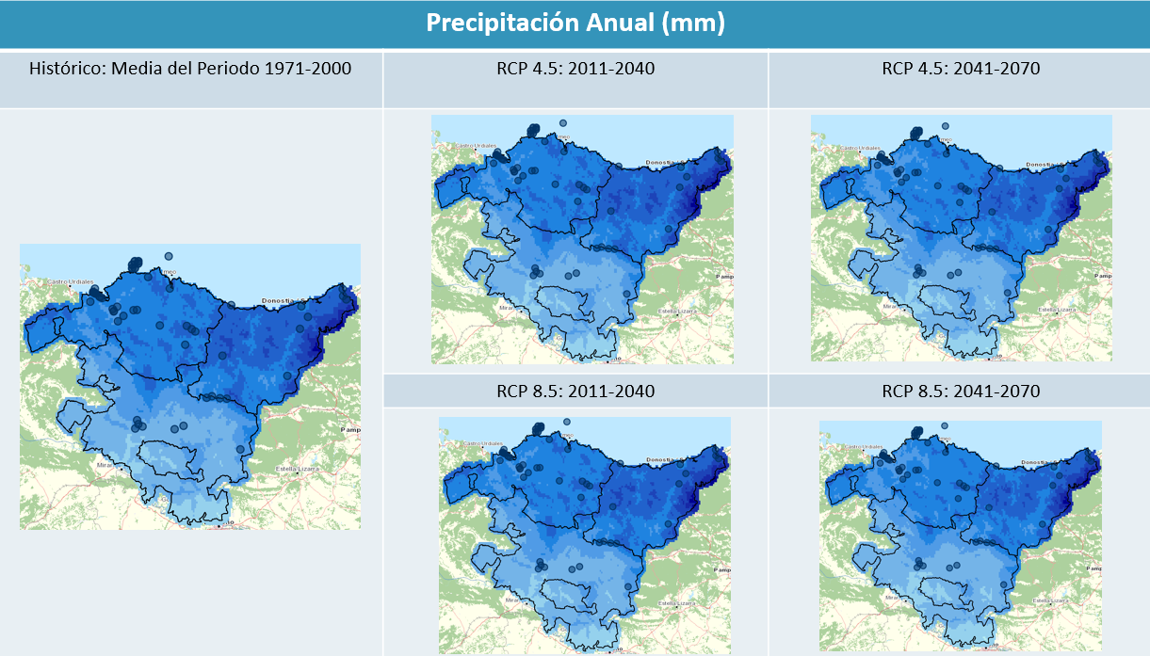
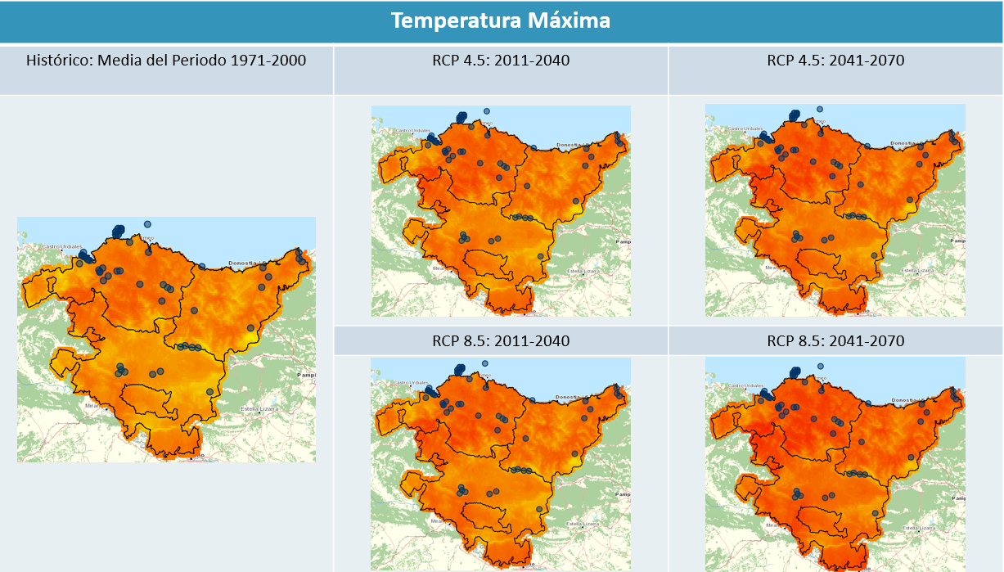
RESET: our first project with SIS data
Evaluation of the climate hazards for the Basque energy sector: An example of the combination of differente sources of climate information:
Most of the variables are coming from the “Basque scenarios”...
… but data coming from the SIS are directly applicable (avoiding a lot or modelling): Relative humidity, Wind potential, River flow and Radiation.

Slide 12
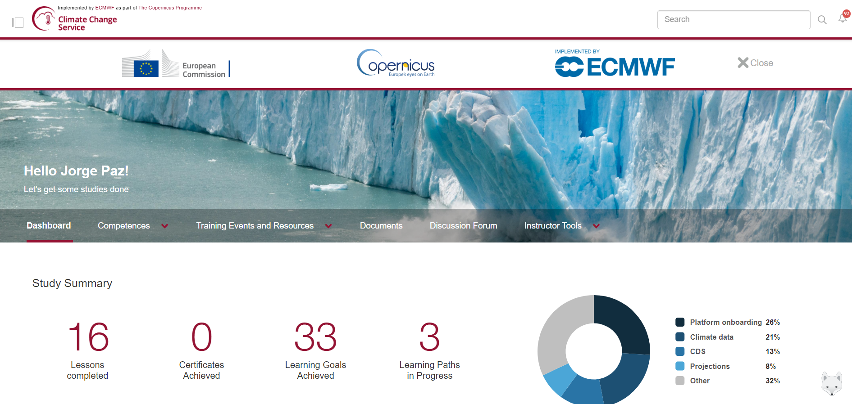
Final messages
Take a look at CDS as a source of climate information.
Stay tuned: more information is coming.
Choose the best strategy / technology: CDS Toolbox, API + local processing environment, etc.
C3S provide more than data: Read the doc (at CDS web, forum, but also at ECMWF, sectorial use cases, etc.)
This is only a brief introduction. A lot or resources are available at the User Learning Service.

Slide 13
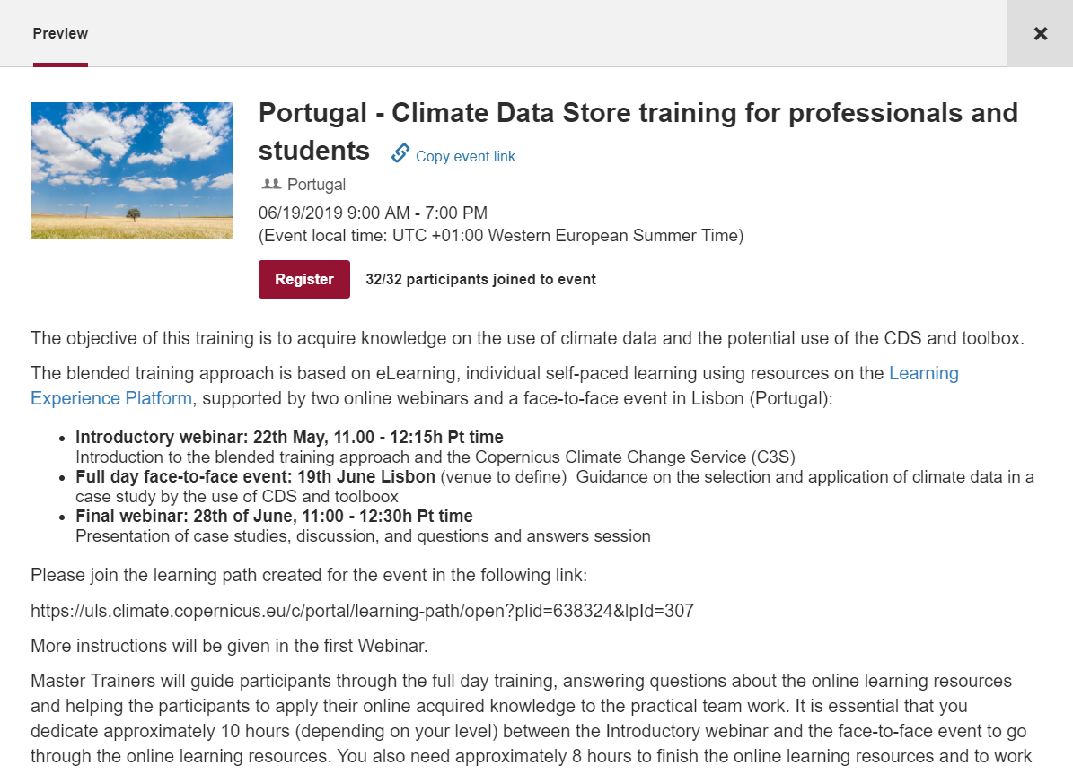
Next training event: Portugal

Slide 14
Additional information
Additional information:
Copernicus Data Store: https://cds.climate.copernicus.eu/#!/home
CDS toolbox: https://cds.climate.copernicus.eu/toolbox-editor/
Copernicus User Support Forum: https://confluence.ecmwf.int/display/CUSF/forum
Copernicus User Learning Service: https://uls.climate.copernicus.eu
Copernicus at ECMWF: https://confluence.ecmwf.int/display/CKB/Copernicus+Knowledge+Base
Panoply: https://www.giss.nasa.gov/tools/panoply/download/
Anaconda: https://www.anaconda.com/
Code: https://github.com/daehon/ECCA2019training
Thank you!!!
Jorge Paz
jorge.paz@tecnalia.com

